Slide 1


Physics (PHY 102) Physical Optics
Farjana Yeasmin
Lecturer in Physics, Basic Science Division
World University of Bangladesh

Slide 2

Objectives
Physical Optics

Slide 3
Physical Optics
The most certain indication of a wave is interference. This wave characteristic is most prominent when the wave interacts with an object that is not large compared with the wavelength. Interference is observed for water waves, sound waves, light waves, and, in fact, all types of waves.
If you have ever looked at the reds, blues, and greens in a sunlit soap bubble and wondered how straw-colored soapy water could produce them, you have hit upon one of the many phenomena that can only be explained by the wave character of light. The same is true for the colors seen in an oil slick or in the light reflected from a DVD disc. These and other interesting phenomena cannot be explained fully by geometric optics. In these cases, light interacts with objects and exhibits wave characteristics. The branch of optics that considers the behavior of light when it exhibits wave characteristics is called wave optics (sometimes called physical optics). It is the topic of this chapter.

Slide 4
Wavefront
The continuous locus of points having the same phase of vibration in a medium through which a wave propagates is called a wave front.
It is a surface composed at any instant of all the points just reached by a vibrational disturbance in its propagation through a medium.

Slide 5
Interference of light
Interference: Due to superposition of two light waves emitted from coherent sources intensity of light increases at some points and decreases at other points. As a result, alternate bright and dark state is produced on a plane. The alternate variation of intensity of light from point to point on a plane is called the interference of light..

Slide 6
Interference of light-conditions
(i) The light sources should be coherent.
(ii) The amplitudes of the two waves producing interference should be equal or almost equal.
(iii) The sources should be very close to each other.
(iv) The sources should be very narrow.
Condition for interference:

Slide 7
Interference of light-types
Constructive interference: If the brightness that is the intensity increases due to superposition of two light waves of same wavelength and equal or almost equal amplitude emitted from coherent sources then the interference is called the constructive interference.
Destructive interference: If zero or minimum intensity is obtained due to superposition of two light waves of same wavelength and equal or almost equal amplitude emitted from coherent sources then the interference is called the destructive interference.

Slide 8
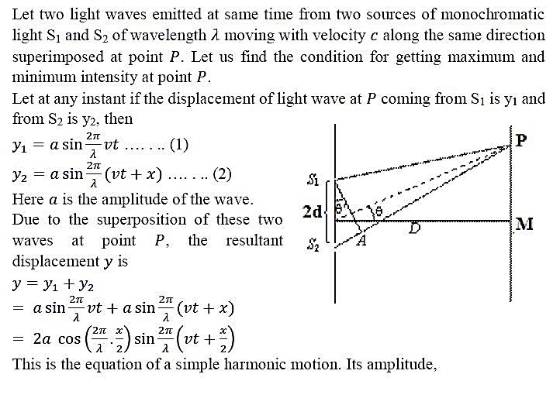
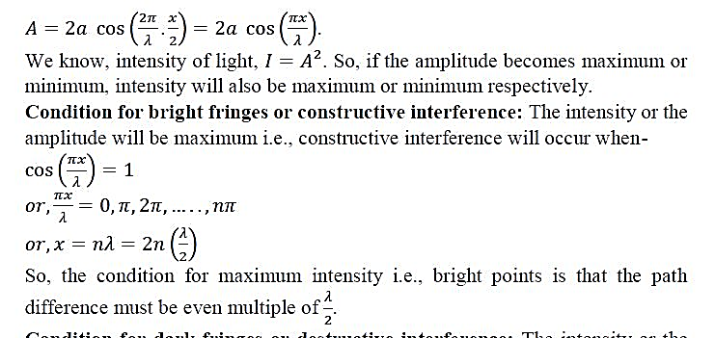
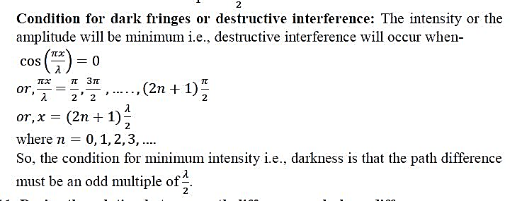
Interference of light-derivation

Slide 9
Conclusions
Thank you

